Slide 1
Examining Social Survey Data STAT-186 Final Project: Team Awesome
Notes:
-Maybe “Design and Analysis with Social Survey Data” would be more appropriate?

Slide 2
Today’s Goals
Demonstrating an application of the concepts discussed during STAT-186
1
Critiquing the use of OLS methods on observational data
Throughout this course, we have witnessed how the use of OLS may not be accurately gauging the true effect of treatments.
This project briefly highlights the primary drawbacks of OLS methods, particularly in observational studies.
2
Structuring a Potential Outcomes framework and analysis plan for an existing research question
We provide an alternative design plan and a potential outcomes framework to analyze the given observational data.
This includes calculating propensity scores, achieving covariate balance and estimating causal effects
We achieve these goals through critical examination of a paper entitled “Education, Intelligence and Attitude Extremity”
Notes:
-This is beautiful but maybe unnecessary. We have a ton of slides so I think we can safely remove it, especially because we didn’t really discuss OLS that much in the project (Agree, MB)

Slide 3
Project Introduction

Slide 4

Background & Motivation
Key Paper: “Education, Intelligence and Attitude Extremity”, Makowsky and Miller, 2014
Objective: Understand whether there are links between education or intelligence, and the extremity of political/social views
Data: Observational data from the General Social Survey
Original study used standard OLS methods as well as quantile regression
Applications in political campaigning and educational policy

Slide 5
Data
Data Source: GSS (General Social Survey)
Time Period: 1972 - 2010
Response Variables: Likert scale responses to numerous economic, social and environmental questions
All response variables were integrated into a composite attitude extremity score
Primary Covariates: Education levels measured through # of school years), “Intelligence” measured through testing data
Other Covariates: Age, race, gender, income, marital status, religious attendance
Notes:
-I would directly say intelligence was measured through a vocab test-”testing data” makes me think of SATs

Slide 6
Original Methods
OLS Regression: The main method used in the study was a standard OLS regression for the effect of education and intelligence on attitude extremity
This method only provided statistically significant results for education upon removal of all other covariates
Quantile Regression: Results were substantially different from OLS, in some cases contradictory
Notes:
-Might be better to merge slides 4-6 into 2 in the interest of length of presentation?

Slide 7
Where The Study Went Wrong
No Potential Outcomes Framework
The study directly compared those who received the treatment (education levels) to those who did not
Observational Data
The study units were not randomly assigned to treatment levels
Covariates Used
There were a limited number of covariates used, and some were improper (recorded after the treatment was assigned)
Notes:
-Under “No Potential Outcomes Framework”, I think the main point is that not using the framework ignores that things are “missing” (acts as if you know everything)
-Under “Observational Data”, don’t need to necessarily add this to slide but at least mention during presentation that this is an issue because using OLS isn’t appropriate when units not randomly assigned

Slide 8
Alternative Study Designs

Slide 9
New Study Design
A brand new study would have the following elements:
Field New Research Rather than use data from the GSS, create a new survey that would record observations more suited to determining causal effects | Individual-Level Covariates Incorporating more proper covariates measured before the treatment would help in stratifying the sample for causal inference
Record Treatment Level The study uses the number of education years to gauge the treatment level. A new study would directly measure the highest degree attained. | Environmental Covariates The study uses the number of education years to gauge the treatment level. A new study would directly measure the highest degree attained.
Notes:
-Instead of “Field New Research” I think “Collect New Data” or something? I may just be a little unclear on the meaning of that
-Under “Record Treatment Level”, we haven’t actually said what the treatment level is yet. Should write it or make sure to explain what that means during presentation
-I think you meant to write something else under “Environmental Covariates”

Slide 10
Design Stage: Existing Data
Given that the data was already been collected, the following steps outline an approach to causal inference using the existing GSS data
Determining Attitude Extremity Based on Education Level
Assignment
No HS
Causal Analysis
Attitude Extremity
High School
Individual
(Race, Gender, religious preference, etc.)
College
Master’s +
Notes:
-I would delete this. We have more than enough slides without it and it looks too much like a DAG I think

Slide 11
Design Stage: Existing Data
Given that the data was already been collected, the following steps outline an approach to causal inference using the existing GSS data
Letting Yi(j) denote i’s potential outcome under the treatment j. The treatment levels represent levels of education based on # of years of education
The probabilities for assignment to education levels were based on existing covariates gender and race.
Potential Outcomes Framework
Units | Y( | W | Gender | Race | Other X
1 | 2.5 | High School | Male | White | …
2 | 2.0 | College | Female | White | …
3 | 1.5 | No HS | Male | Black | …
…
Notes:
-We really want to separate the “Design phase” from anything with outcomes so I would rename this something like “Potential Outcomes Framework” or even have “Set-Up: Potential Outcomes Framework” (and make the next slide a “Set-Up” slide too) (and get rid of sub-header)
-There is no clear definition of what our “outcome” is and what our “treatment levels” are
-Small typo in header of second column in table
-Remove Gender

Slide 12
Design Stage: Existing Data
Given that the data was already been collected, the following steps outline an approach to causal inference using the existing GSS data
Assumptions
SUTVA:
Education level of one unit does not affect other units
Multiple treatment levels, but no hidden treatment
Consistency of education levels:
All schools are the same (private, public, etc.)
Quality of every educational year is equivalent
Unconfoundedness:
Weak unconfoundedness assumption for individual treatment levels, not jointly
Randomness of Missing Responses
Notes:
-I think “Assumptions” or “Set-Up: Assumptions” might be more appropriate
-I think the way Kiran and I discussed the SUTVA assumption, we didn’t make an assumption of consistency of education levels. We defined the treatment levels coarsely as just “highest degree attained” to try to avoid those issues.

Slide 13
Design Stage: Existing Data
Given that the data was already been collected, the following steps outline an approach to causal inference using the existing GSS data
Design Issues
Improper Covariates
Income determined mostly after receiving the treatment
Marital status also primarily after the educational treatment
Explored the use of principal stratification, but ignored this option for the purposes of this project
“Intelligence”
Original study leveraged vocabulary tests to determine natural intelligence
Affected by the treatment
Not included in posited study design
Notes:
-Small typo in sub-header: remove the “been”
-Instead of income “determined” after receiving treatment might say it was measured after receiving treatment
-I would just leave it at “Explored use of principal stratification”
-I’m not sure if it was “natural” intelligence
-I would love a bullet on factorial design too. We don’t have to go into detail on principal stratification or factorial design because we have so many slides, but I think the fact that we discussed “sophisticated” ways to deal with these issues is important to say. I think that should be more the focus of this slide. If I’m presenting this slide my idea would be to introduce how these things could have been used and why improper covariates/intelligence were issues, but then explain that for the purpose of this project we focus on the issue of dealing with multiple treatment levels

Slide 14
Design Stage: Existing Data
Given that the data was already been collected, the following steps outline an approach to causal inference using the existing GSS data
Propensity Score Analysis
Generalized Propensity Scores (GPS):
Multiple Treatment levels dictate the use of GPS rather than usual propensity scores
Unordered multinomial model despite education levels: deviance comparison between ordered and unordered models yields better results for unordered version
Different education levels could have varying non-linear impact
Covariates: Race, Religious Preference and Hispanic indicator
Excluded Covariates:
Age is not proper as measured after treatment assigned
Income unsuitability already discussed
Notes:
-I don’t think we need the sub-header on all these pages, there is enough writing without
-I would delete last bullet under “Generalized Propensity Score” and just leave it at “Used multinomial model”. If someone asks about it then Kiran has a pretty good explanation but we should try to avoid getting bogged down in things people might not agree on
-I would make a note here that we carried out the GPS method but do not claim that our design truly captures the “science” (because we ignored many complications); we basically are just trying to exemplify how one difficult aspect (multiple treatment levels) could be dealt with. We might even say that here other methods may have been more appropriate since there are so few background covariates, but we are just trying to show one method

Slide 15
Design Stage: Existing Data
Given that the data was already been collected, the following steps outline an approach to causal inference using the existing GSS data
Propensity Score Analysis (Contd.)
Generalized Propensity Scores (GPS) Model:
INSERT FORMULA HERE
Each unit will have a vector of probabilities of assignment to each treatment
Interaction and quadratic terms not included due to computational time and lack of supporting domain-specific rationale
Data Cleaning:
After propensity score estimation, units outside of common range of scores were deleted
Most units were retained (only 1% excluded)
Sub-classification:
Sub-classification not easily invoked for vector of propensity scores and current literature less clear on best method for use with GPS
Notes:
-sub-header
-I would say “trimming” not data cleaning

Slide 16
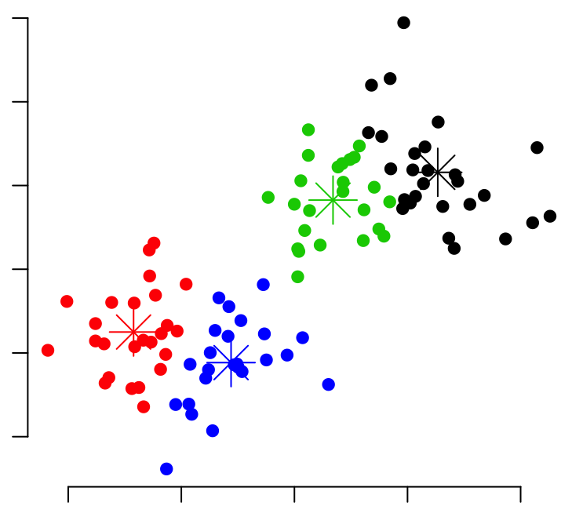
Design Stage: Existing Data
Given that the data was already been collected, the following steps outline an approach to causal inference using the existing GSS data
Subclass Creation: K-Means Clustering
Clustering on Vector of Propensity Scores:
K-means clustering algorithm can use multidimensional data to determine unique groups based on covariates (e.g. Tu et al)
Two Methods:
Guess and Check: Start at 1 cluster, check balance. If balance not ideal and sample size sufficient, increase number of clusters by 1. Repeat until best balance is achieved with min. number of clusters
1-Dimensional Analog: Cluster balance is checked using MANOVA test. Every cluster with bad balance and sufficient sample size is split into two. Repeat process until size lower bound attained.
Notes:
-sub-header

Slide 17
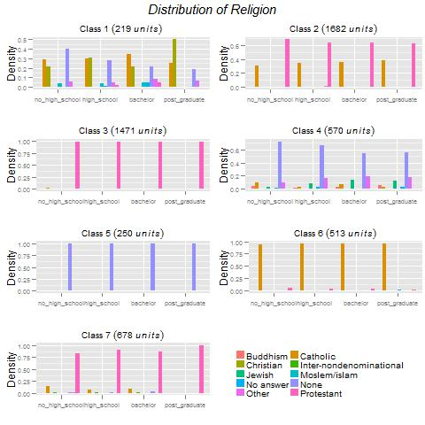
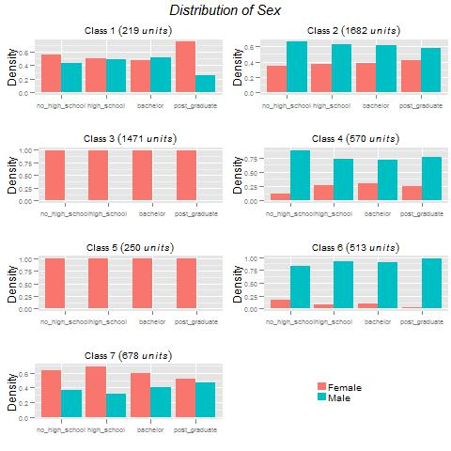
Design Stage: Existing Data
Given that the data was already been collected, the following steps outline an approach to causal inference using the existing GSS data
Cluster-Level Balance
Notes:
-sub-header

Slide 18
Analysis Stage

Slide 19
Analysis Stage
Once the units have been assigned to the appropriate subgroups, analysis to determine the causal effects of educational levels on extremity can begin
Causal Estimands
To calculate the causal estimands for the respective treatment effects, we implemented a tiered approach:
Within-Cluster Average Treatment Effect:
Global Treatment Effect through Weighted Averages Across Clusters:
Notes:
-It’s not sure if I would call them ”treatment effects” because we aren’t really comparing one thing to another; it’s just estimating average potential outcome under each treatment

Slide 20
Analysis Stage
Once the units have been assigned to the appropriate subgroups, analysis to determine the causal effects of educational levels on extremity can begin
Results
RESULTS SUMMARY
Notes:
-I don’t think we need the sub-header on all these pages

Slide 21
Analysis Stage
Once the units have been assigned to the appropriate subgroups, analysis to determine the causal effects of educational levels on extremity can begin
Results (Contd.)
Results Charts For Respective Groups
Notes:
-sub-header

Slide 22
Conclusion

Slide 23
Summary
Study
Design
Analysis
OLS Framework does not allow for potential outcomes framework
Presence of improper covariates
Non-Random treatment assignment
Remove improper covariates from consideration
Use Generalized Propensity Score model for multiple treatments
K-Means clustering to group units with similar score vectors
Causal estimates determined at the cluster level
Weighted average across clusters leads to net causal effect of treatment
Results indicate there to be a significant effect for High School on attitude extremity
Other inferences outside of acceptable margins of error
Notes:
-I wouldn’t sat OLS framework doesn’t “allow” for potential outcomes; I would just say it’s not appropriate in this setting
-Instead of saying we “removed” improper covariates I would say we “discussed” how to deal with them

Slide 24
Future Work
Implement Principal Stratification
Leverage covariates beyond those used in the source paper
Conduct brand new study to address the research question
Notes:
-We need a reference slide

Slide 25
Questions?

